Slide 1

Monsanto’s Geo-Imagery Pipeline
A Holistic Approach to Automatically Ingest and Process Imagery From Multiple Sources
Dean Hand / Martin Mendez-Costabel

Slide 2
Agenda
Overview of Imagery at Monsanto
High Level Data Flow
Data Access Patterns
Satellite
MAV
UAV
Next Steps

Slide 3
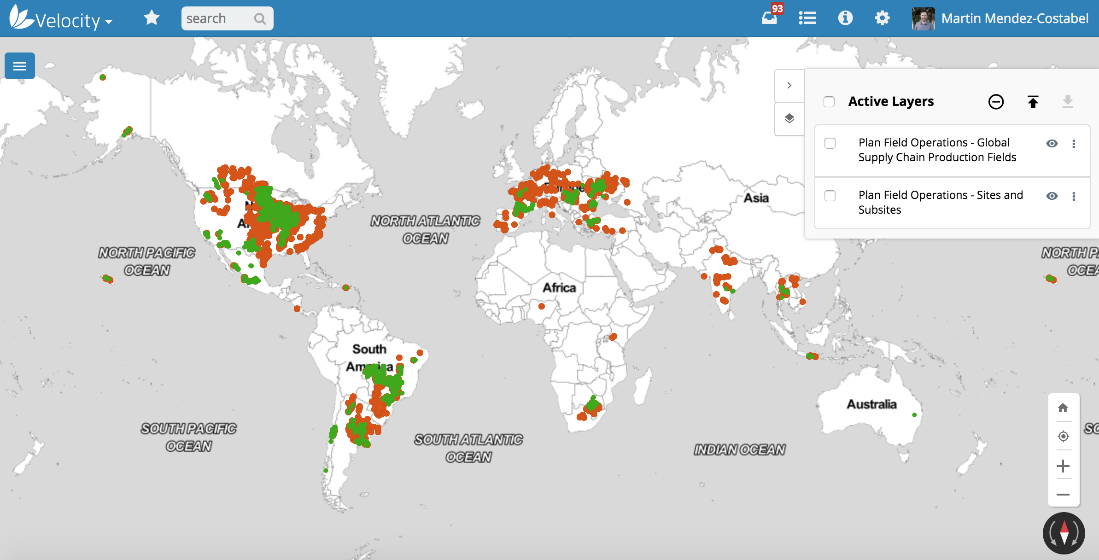
Imagery at Monsanto
MAV/UAV/Satellite/Rover
Global, small plot and large fields
Multi sensor, multi platform
Imagery as enabler, not the final goal

Slide 4


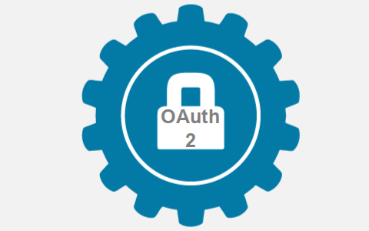















High Level Imagery Data Workflow
Data Ingestion
Security
Authorization
Identity Management
Systems of Access
Virtual Directory Service
Partners
Imagery
Trusted Partner Portal
MON
Authentication
API
Gateway
Data Front Door
Enterprise Application Framework
Google
Velocity Maps
Vendors
Core Data Asset
Geospatial Platform
Metadata Management
Haystack
Desktop Access
AWS
Mobile
MON
Internal
Users
MON non spatial systems
Field Systems
Geospatial
Data Repository
SAP
Analytics

Slide 5

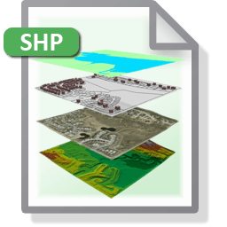






Data Access Patterns
Data Scientists
Data Sources
BI
IoT Data
Streaming
Upload
Access
Gateway
Apps
Mobile
Webapps
Geospatial Engine
(Tiles/Layers)
Data
Catalog
API
Footprints WFS
End Users
Non-API
S3

Slide 6
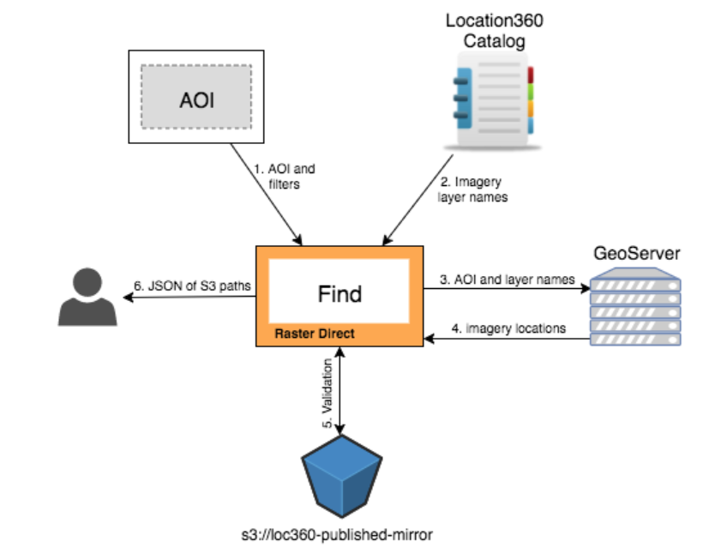
S3 access pattern
‘Raster Direct’
Python CLI tool
Search and discover
Domino integration
Leverage a WFS
to spatially query
the footprints, then access
imagery directly from S3

Slide 7
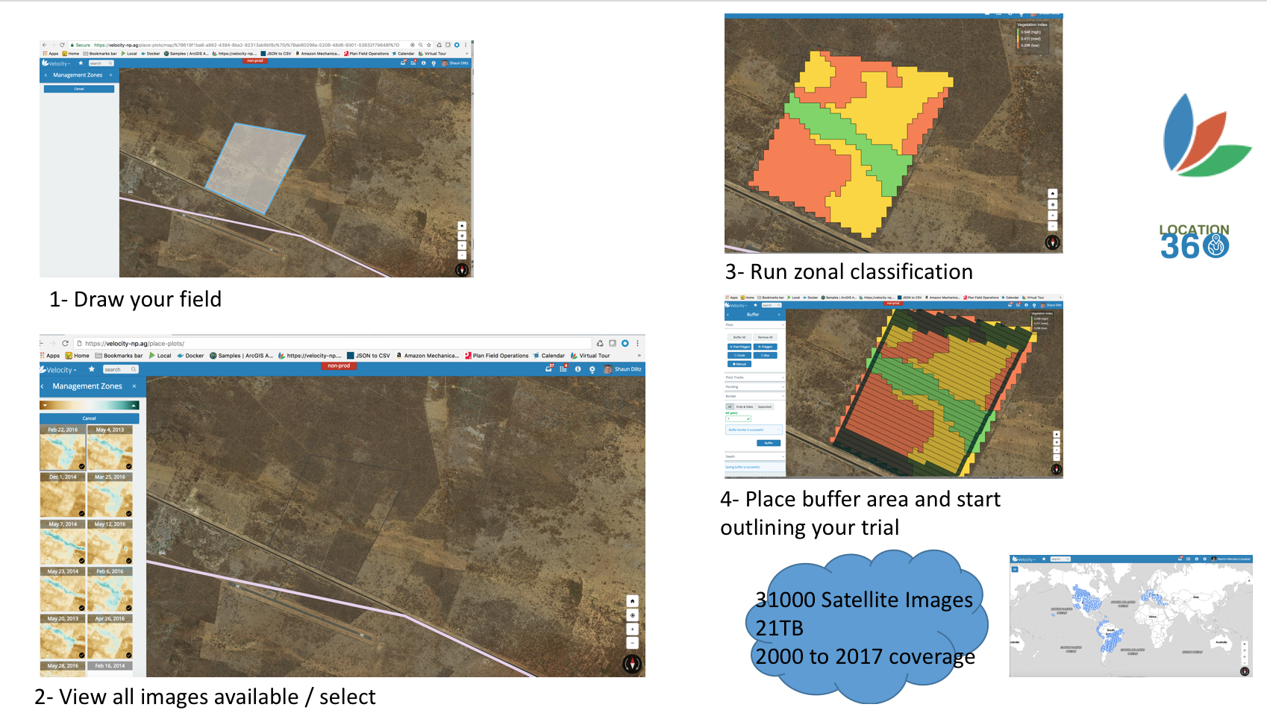
Satellite Pipeline
Landsat/Sentinel/Private
Cloud masking
Automated ingestion and processing
Insights built on real time

Slide 8
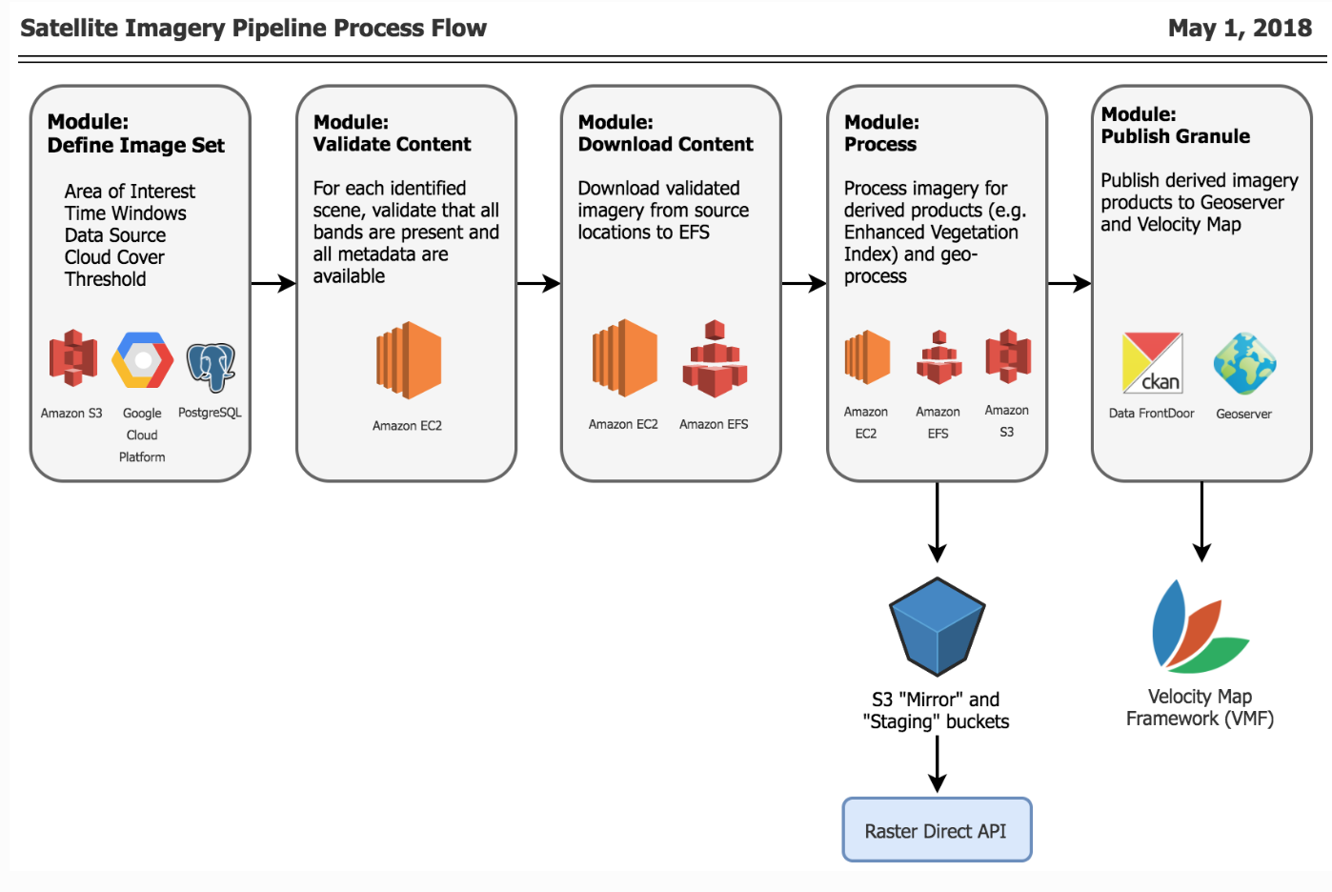
Satellite Pipeline (cont.)

Slide 9
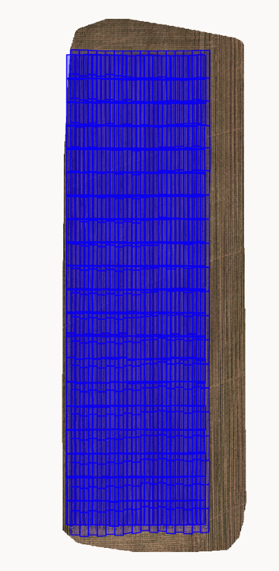
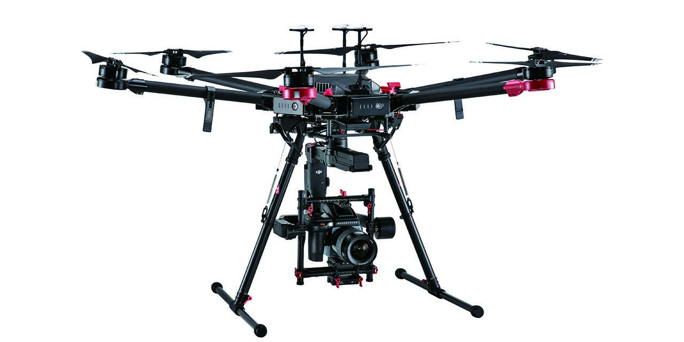
UAV Pipeline
Platform: DJI (M600Pro) and Microdrone
On-board custom firmware
Custom Mission Planning iOS app (Discover)
Sensor: SONY DSC-RX1RM2
Imagery
Ortho-stitched with OpenDroneMap
Ground Control Points for Georeferencing
Analytical models generate metrics
Imagery Types
RGB
Near-IR (coming)
Thermal (coming)
LiDAR (coming)

Slide 10
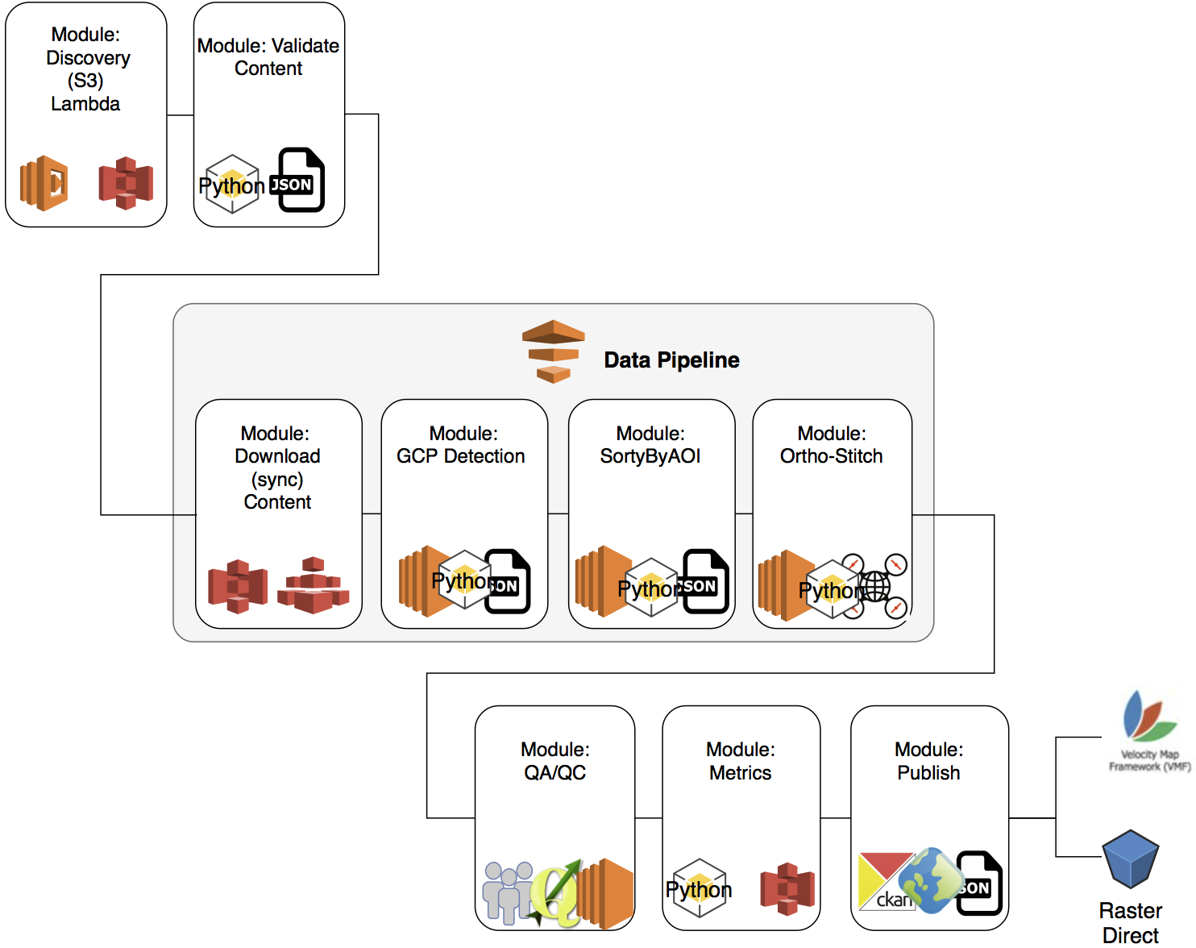
UAV Pipeline (Cont.)
UAV Imagery Workflow 10 May 2018

Slide 11
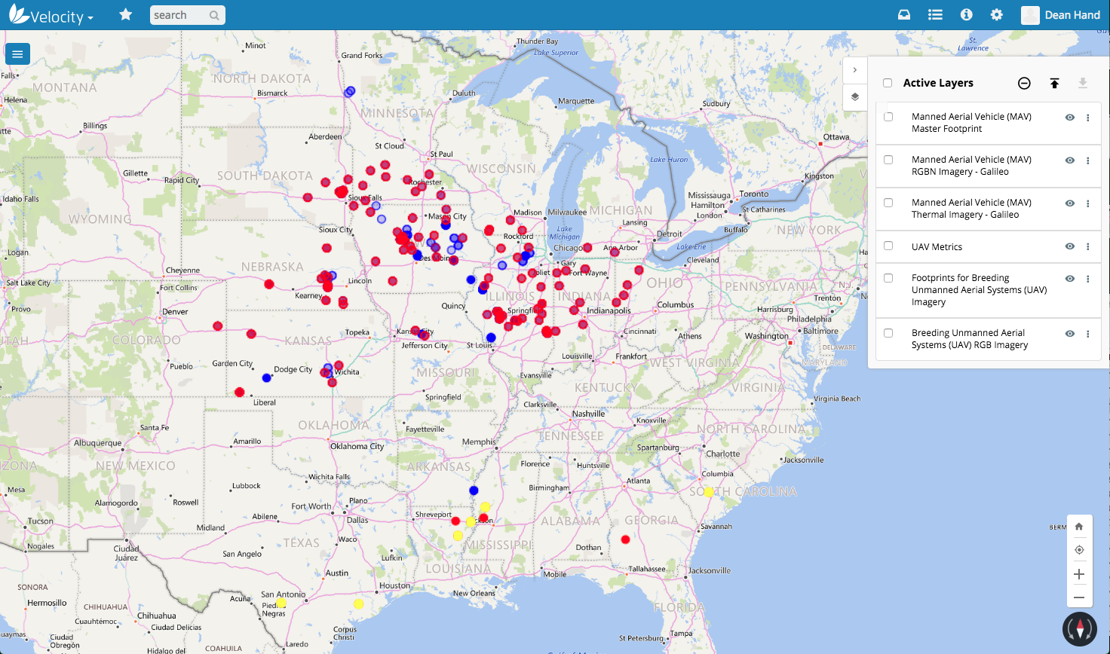

Slide 12

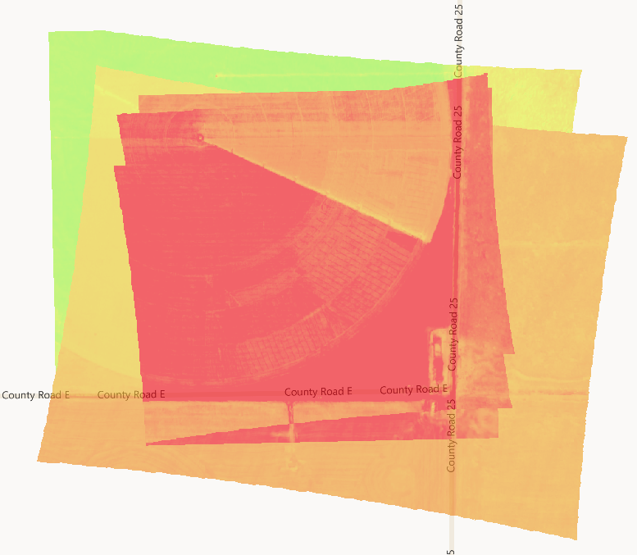
MAV Pipeline
Variety of Vendors and Platforms
Sensors include
RGB
Near IR
Thermal
Imagery is processed
Analytical models generate metrics

Slide 13
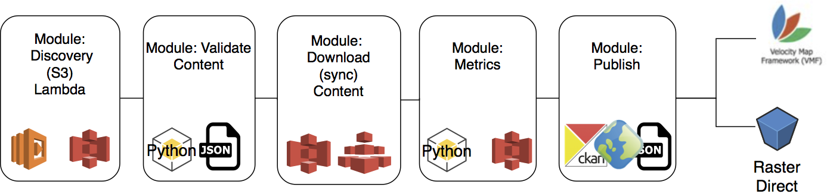
MAV Pipeline
MAV Imagery Workflow 10 May 2018

Slide 14
Next Steps
Further integration of tiles and layers
Integration of Google Earth Engine and select datasets (process within GC then only move outputs)
Minimize EFS

Slide 15
Thanks

